Slide 1


Data Governance @ SneakerPark
Prepared by: Dotty Johnson
Submitted on: 20-06-2021

Slide 2
Step 1
Enterprise Data Catalog Part 1: Enterprise Data Model

Slide 3
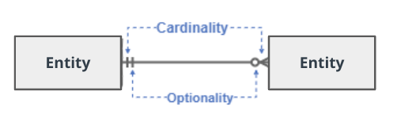
Create a conceptual data model that will provide SneakerPark with a holistic view of its data systems and help you grasp the organization's important entities and relationships, which will be instrumental as you move further in the project. You can use Lucidchart or any other diagramming tool of your choice, but please use the Crow’s Foot/IE Notation and please be sure to indicate both cardinality (the type of a relationship such as 1:N or N:N) and optionality (whether the relationship is optional or mandatory).

Slide 4
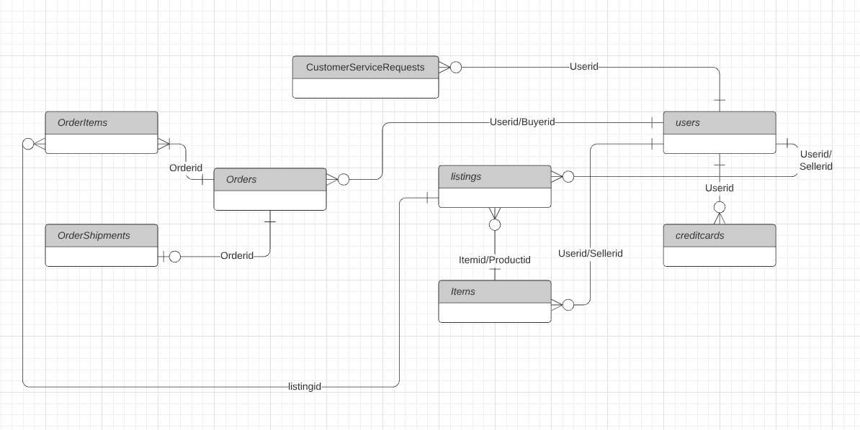
Replace the example below with your own solutions (obviously feel free to take more space):

Slide 5
Step 2
Enterprise Data Catalog Part 2: Metadata

Slide 6
Create the first version of the Metadata Catalog by documenting the metadata from all systems in the "Data Dictionary" and the “Enterprise Data Catalog” tabs of the provided Sheets template.
Please note that you are required to fill out all fields in both tabs.

Slide 7
Step 3
Data Quality
Part 1: Profiling and Cleansing

Slide 8
Profile the data to identify at least 3 data quality issues you see in the data. Also provide at least 1 data quality issue that you haven’t yet seen in the data, but can foresee occurring in the future. Based on the issues you’ve identified, come up with the data quality rule for each data quality issue, including for the one that you foresee.
Make sure you fill out all columns in the "Data Quality Issues" tab with your answers in the provided Sheets template.

Slide 9
Step 4
Data Quality
Part 2: Monitoring

Slide 10
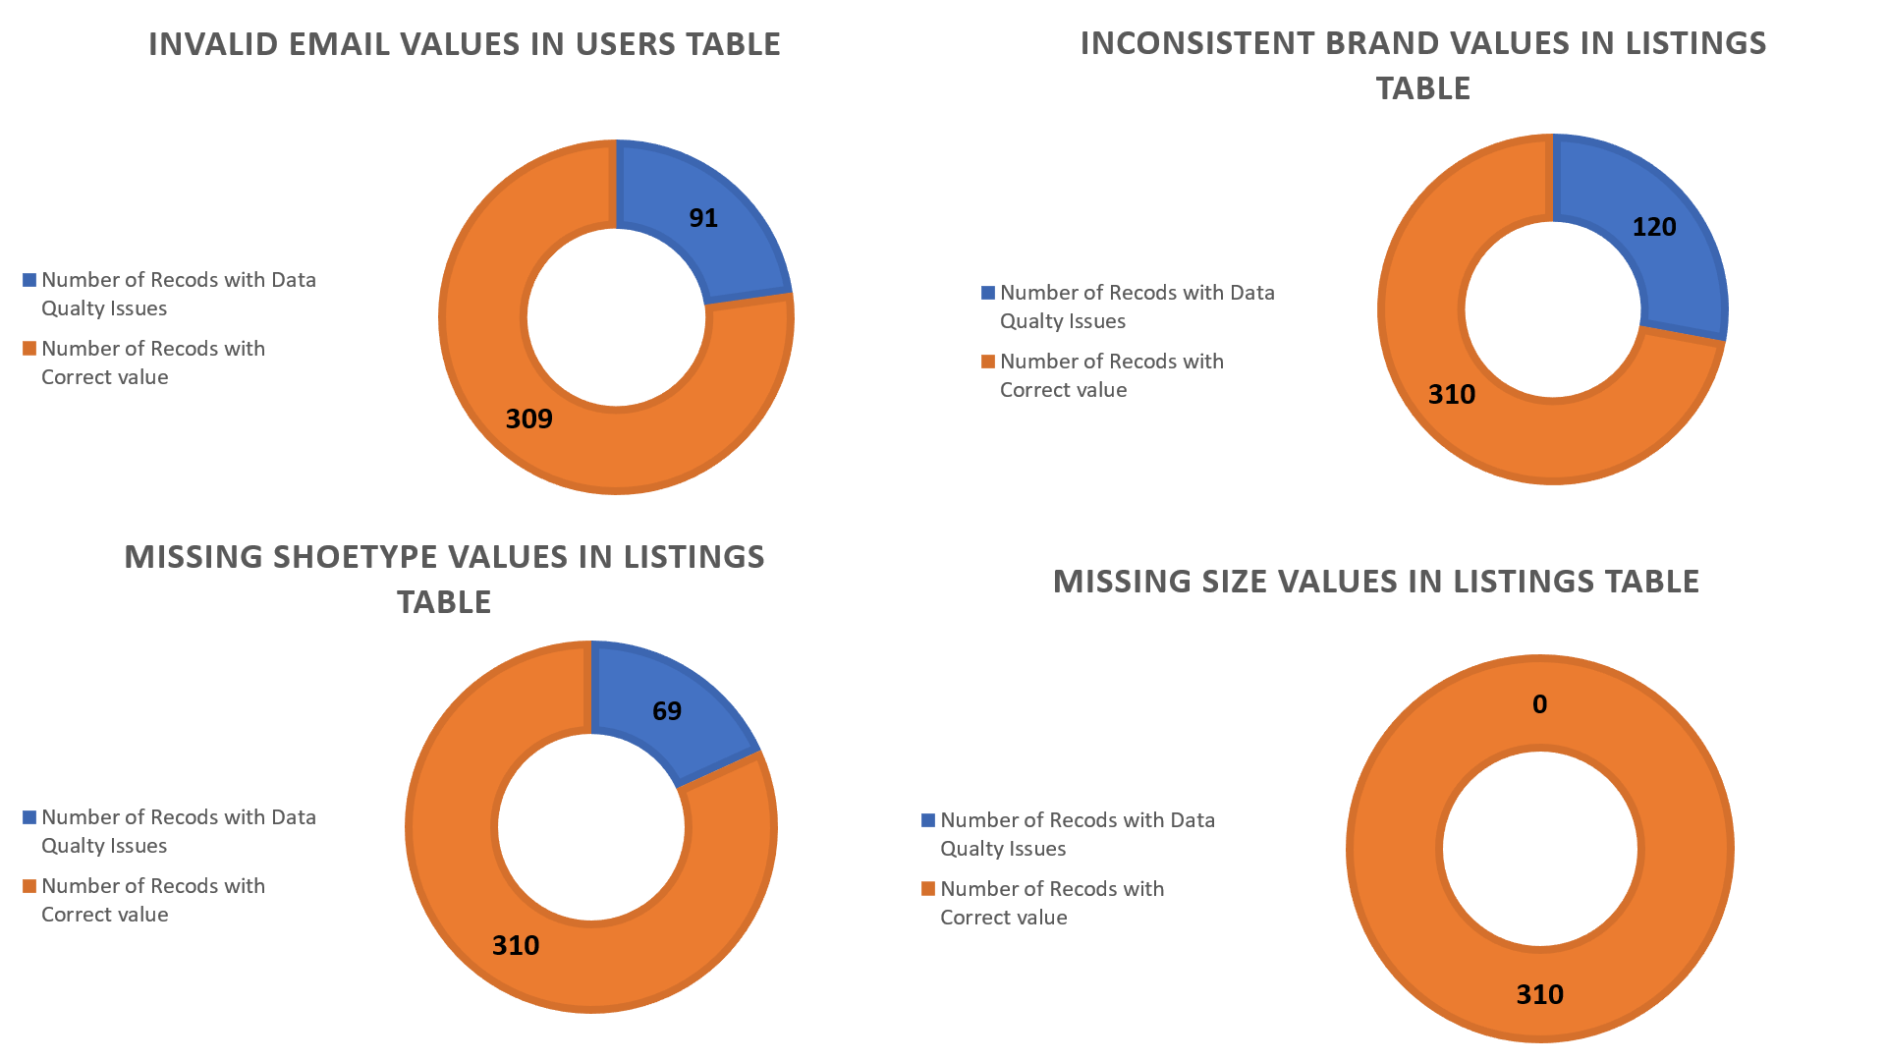
Using the metrics you've created in the last step, please create a mock-up of a data quality monitoring dashboard that will be used to monitor the data to ensure compliance with your data quality rules.
Please make sure to label your metrics clearly on your mock-up.
Replace the example dashboard below with your own. (obviously feel free to take more space).

Slide 11
Step 5
Master Data Management
Part 1: MDM Architecture

Slide 12
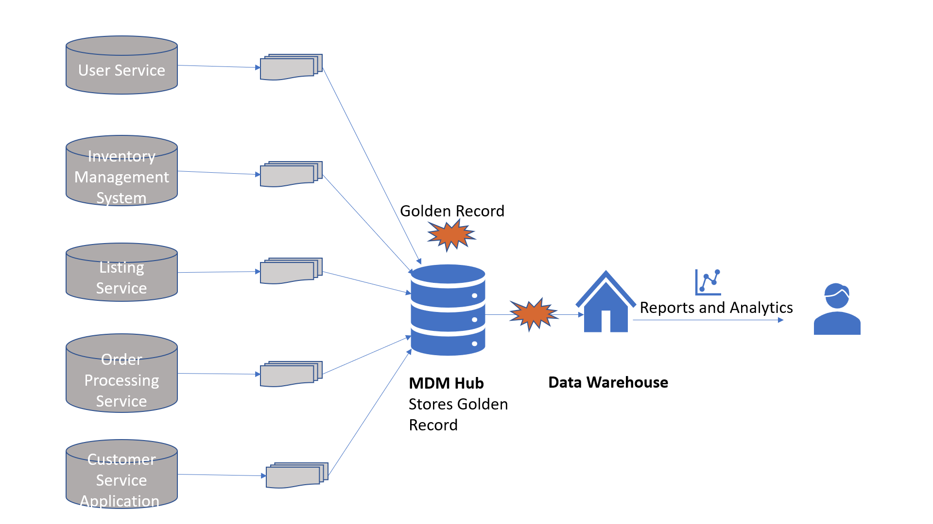
Based on what you’ve read about SneakerPark’s systems and business model, sketch out a proposed MDM implementation architecture, and write a detailed explanation of why you chose this specific approach.
Tip: Think about how your plan and its implementation might affect existing systems.
Replace example screenshot below with your own solutions (obviously feel free to take more space).
Next, please write at least a paragraph explaining your choice.

Slide 13
Explanation:
Consolidated MDM architecture was used for Sneaker Park. In Consolidated MDM Master data from different source systems is consolidated and stored in MDM hub. This process done in batches at some regular intervals such as hourly or daily.. In this style, the master data flows in one direction, more specifically from the source systems into the MDM Hub. The requirements from Sneaker Park states that the MDM system has to be minimally disruptive to the operation of its critical systems. It also states that there are some nightly batch exports that are used to exchange data between these services and the rest of Sneaker Park's systems. This works with respect to Consolidated MDM architecture as they are minimally disruptive and uses batch jobs.

Slide 14
Step 6
Master Data Management
Part 2: Master Record

Slide 15
In this step, you will define a set of matching rules that will be used by the SneakerPark's MDM Hub to match item and customer entities between the company's different systems.
Please come up with 4 rules - 2 for Items and 2 for Customers and list them below.
For Customers:
Match customer data on Userid
Match Customer data on Firstname and Email
For Items
Match Items data on Itemsid
Match Items data on SellerID, Type, BrandName, Color, Sex, Size, Condition

Slide 16
Step 7
Data Governance:
Roles and Responsibilities

Slide 17
Write 1-2 paragraphs discussing what data governance roles and responsibilities will be necessary to oversee this new Data Management initiative. Please be sure to discuss the responsibilities in the context of at least 3 different aspects of Data Governance (such as Data Quality Management, Metadata Management, MDM, etc). Based on what you know, do SneakerPark's current employees have the necessary skills for these roles or should the company make new hires?
Role1: Technical Data Stewards
Data Stewards create the match rules for golden record generation which is important for MDM functioning. In certain situations they Override match results by manually updating the golden records.
Role2: Business Subject Matter Experts/ Business data steward
Responsible for measuring and montoring data quality, documenting and maintaining data catalogue.
Role3: Data Owners
Specifies the business requirement for data and quality and is responsible for data in a particular Data Domain
Sneaker Park has 1 SME and 1 technical IT support employee. I think the company should hire more employees for handling data stewardship for each department/domain to share the responsibilities.

Slide 18
Standout Suggestions

Slide 19
Create a Business Glossary for SneakerPark and define common terms such as Item, Buyer, etc. Think and discuss how SneakerPark can improve on the consistency of the terms that its systems currently use. (You can use the “Business Glossary” tab of the same Sheets template you’ve been using for the other parts of this project to get you started.)
Document SneakerPark’s current naming conventions. Can you think of any improvements? (You can use the “Standard Naming Conventions” tab of the same Sheets template you’ve been using for the other parts of this project to get you started.) Some examples of Naming Conventions include;
Do not use spaces or special characters.
Use only LOWERCASE.
All identifier fields should end in “_id”.
Avoid acronyms and abbreviations.
Write SQL scripts for the matching rules that you’ve created in Step 6.

